Slide 1
Applying Cross Validation
Presented by:
Keith Fitzhugh
Notes:
This morning I will be reviewing the practice of cross validation, we’ll talk about how this concept is applied and the importance of it
When building a predictive model our # goal is accuracy.
That what defines the success of a predictive model
Step 1: Defining the Objective
Step 2: Gathering the Data Step 3: Preparing the Data for Modeling Step 4: Selecting and Transforming the Variables Step 5: Processing and Evaluating the Model Step 6: Validating the Model Step 7: Implementing and Maintaining the Model
Preparing the Data for Modeling
This is a way of estimate the out of sample error rate for predictive models
CONCEPT OF:

Slide 2
Splitting the data
Training
Set
Test
Set
Validation
set
Notes:
When building a predictive model
Splitting data randomly is a good practice. Some times data could be store alphabetically or sorted in away that negatively distort your model
#Doing this, we can estimate the out of sample error rate for predictive models

Slide 3
Why use cross validation (CV)
Helps evaluate the predictive performance of a model
Gives insight on how model will generalize to an independent dataset
Comparing different predictors
Avoiding overfitting
Notes:
When building a predictive model, our goal is accuracy. Ultimately that’s how we determine its value. Data Science as a whole ; the more successful you are…
As data scientist accuracy is key. Of course we want our model to be over reactive to the training set

Slide 4
types of (CV)
Bootstrap Methods
Holdout method
K-Fold CV
Leave one out CV
Notes:
Here are a few common types of cross validation:

Slide 5
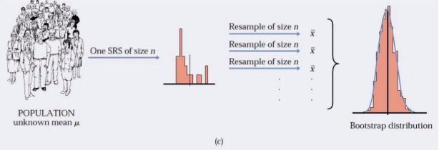
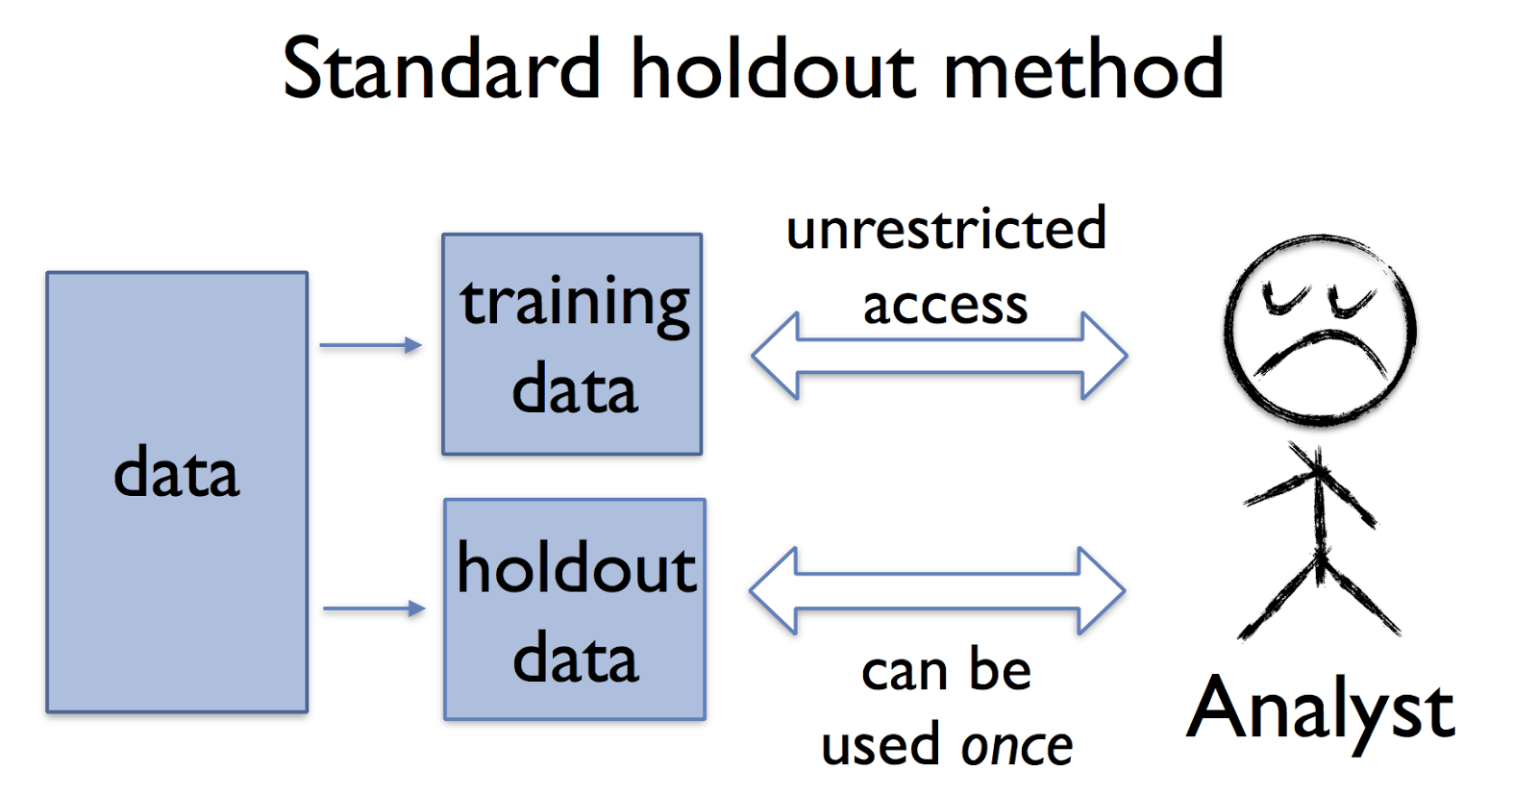
Bootstrap Methods Used when working with a small sample size Sampling with replacements
Holdout Methods
used mostly with large datasets
dataset is divided into two subsets:
Training set
Test set
Notes:
Bootstrapping disadvantages- we could resample a single observation several times
Holdout – Data is broken down into
disadvantages – we leave out a significant amount

Slide 6
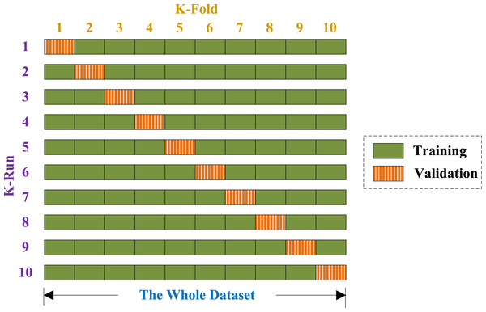
Notes:
K-fold cross validation is one way to improve over the holdout method. The data set is divided into k subsets, and the holdout method is repeated k times. Then the average error across all k trials is computed

Slide 7
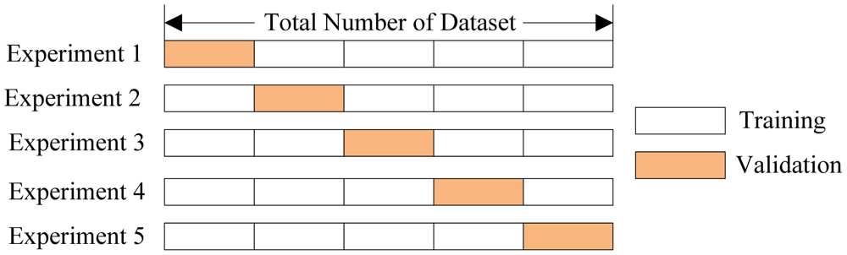

Slide 8
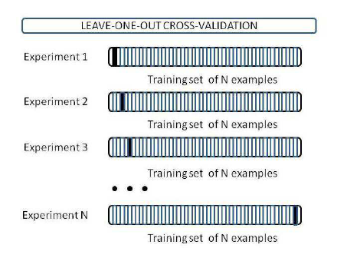
Notes:
Leave one out method
High computation cost: re-learn everything n times
If dataset is 100,000 – We train the data 100,000 times
Train on all (n-1) except for one instance e.g 1000 - 999 training set 1 for testing set n= # of instances

Slide 9
Takeaways
Cross validation estimates have variance
Training and test set must both come from the same population
Sampling should be designed to mimic real patterns
Notes:
Training set and test set both must come from the same population and the test set must not be used until we’ve finished adjusting or tweaking our model on the training set.
Cross validation estimates have variance
Out of sample error is subject to error as well
If there is sampling involving time data it should be trained accordingly

Slide 11
Notes:
What Is R-squared?
R-squared is a statistical measure of how close the data are to the fitted regression line. It is also known as the coefficient of determination, or the coefficient of multiple determination for multiple regression.

